Slide 1
Lego Box Recognition
Sun, Lyu, Zhang, Chen
27 May 2016

Slide 2
Image Preprocessing

Slide 3
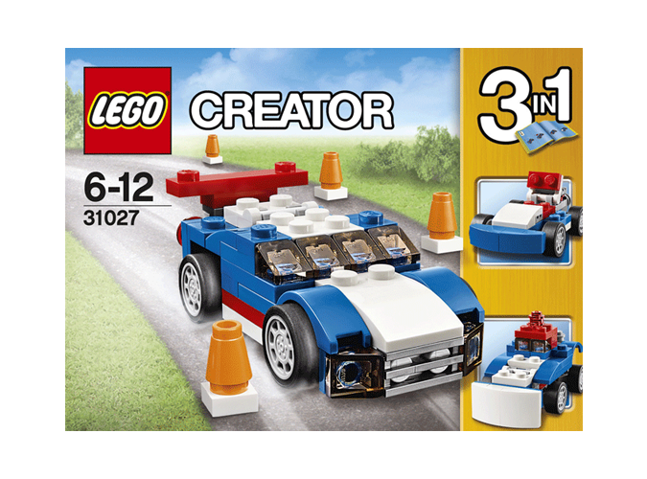
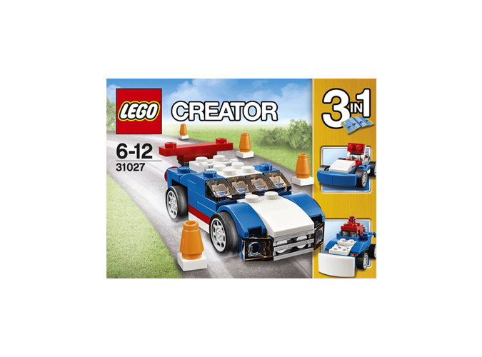
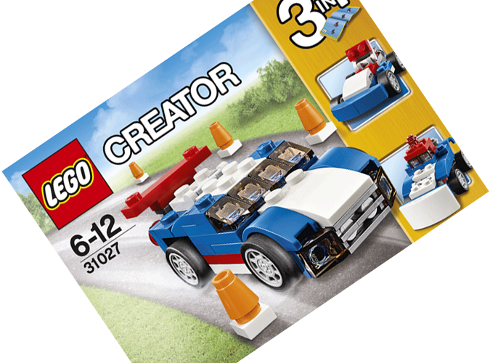
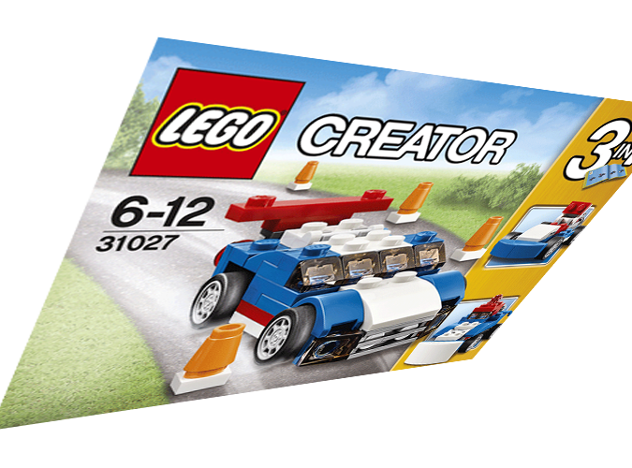
Image Preprocessing
Standard form
Scaling change
Rotation
Perspective transform
We use image preprocessing to recover the shooting box to standard form from any shooting angle and extract the area of the number.
Area of number is the area under the logo in the image.
Standard form was defined as the box surface parallel with the shooting camera and the texts are normal morphology in the image.

Slide 4
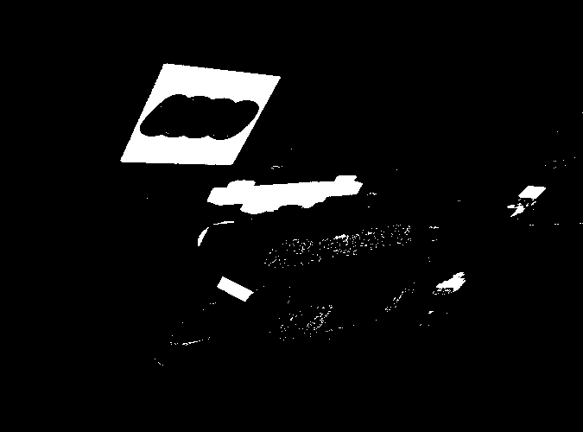
Image Preprocessing
Step1: Using HSV color space to find the red area in the image. The result is a mask.

Slide 5
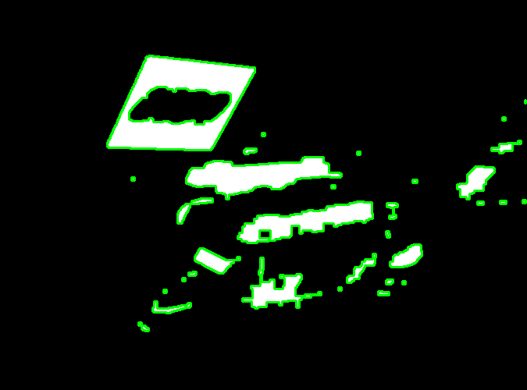
Image Preprocessing
Step 2: Finding all contours from the mask.

Slide 6
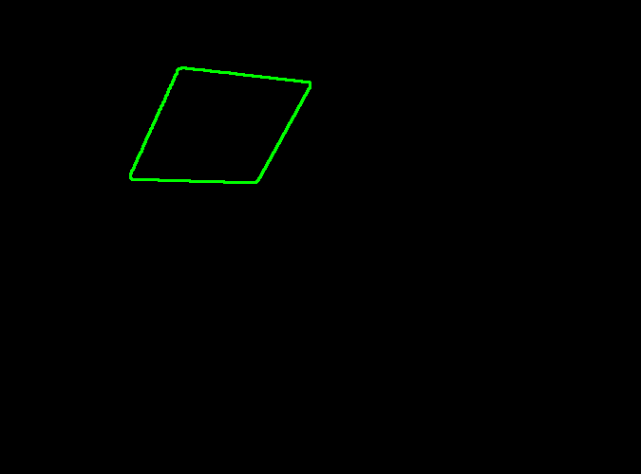
Image Preprocessing
Step 3: Picking the biggest quadrilateral from the contours by some geometric attribution.

Slide 7
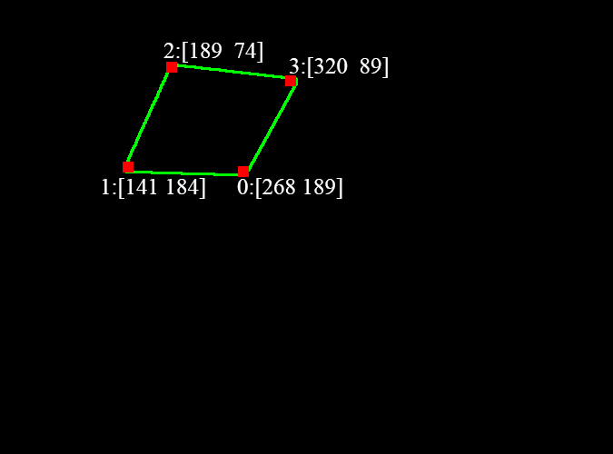
Image Preprocessing
Step 3: Detecting the four corners by Harris method. It could also verify the contour is a quadrilateral.

Slide 8
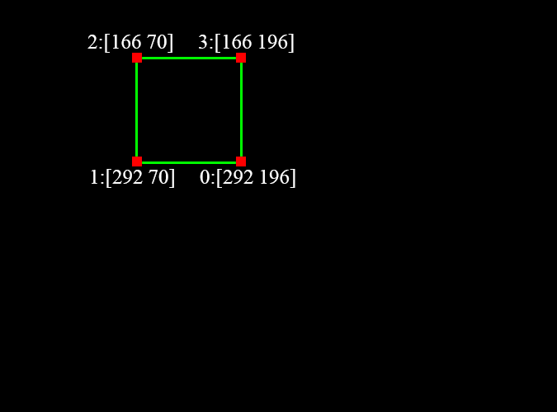
Image Preprocessing
Step 4: Creating a standard square preparing for affine transform.

Slide 9
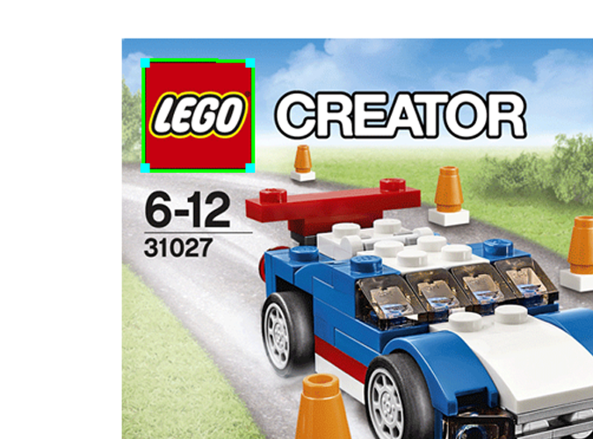
Image Preprocessing

Slide 10
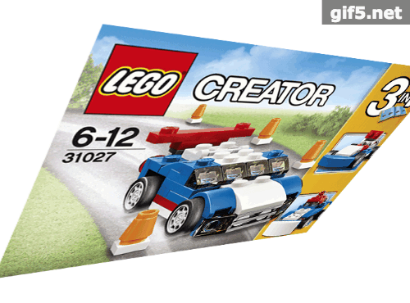
Image Preprocessing

Slide 11
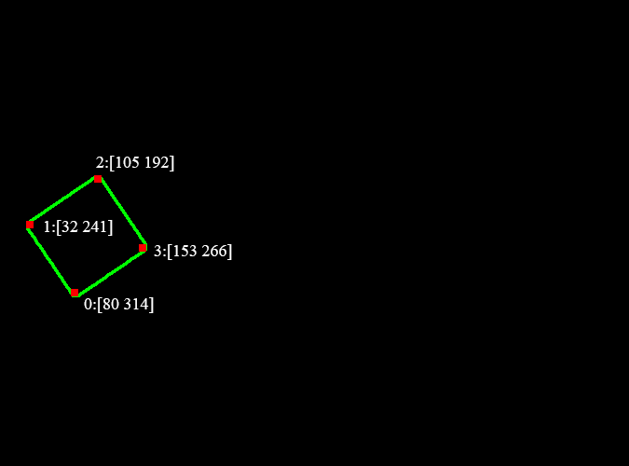
Image Preprocessing

Slide 12
Image Preprocessing
2
1
0
3

Slide 13
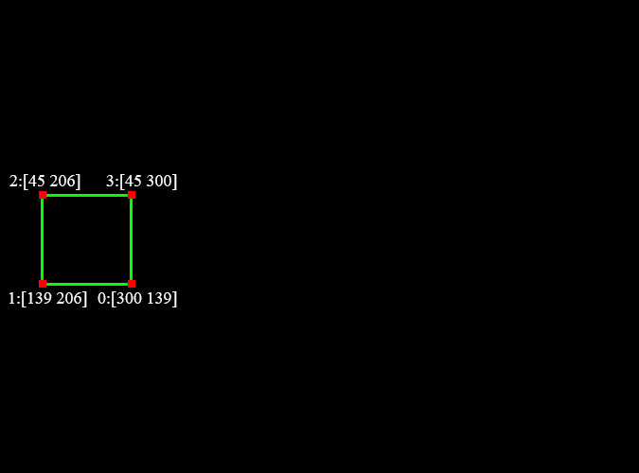
Image Preprocessing
2
1
0
3

Slide 14
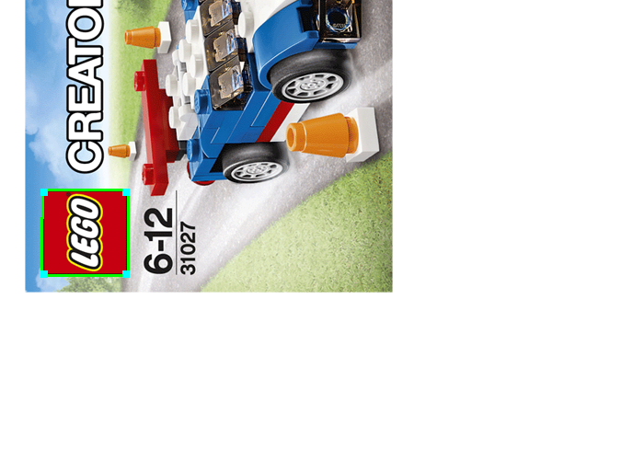
Image Preprocessing
2
1
0
3

Slide 15
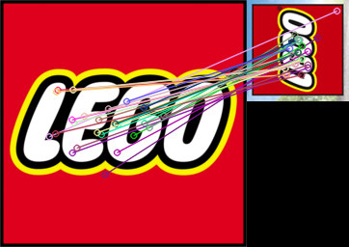
Image Preprocessing

Slide 16
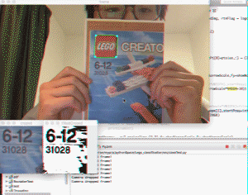

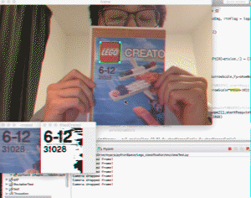
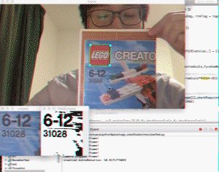
Image Preprocessing
Scaling
Rotation
Perspective
transform
Figx. Implementing result

